Slide 1
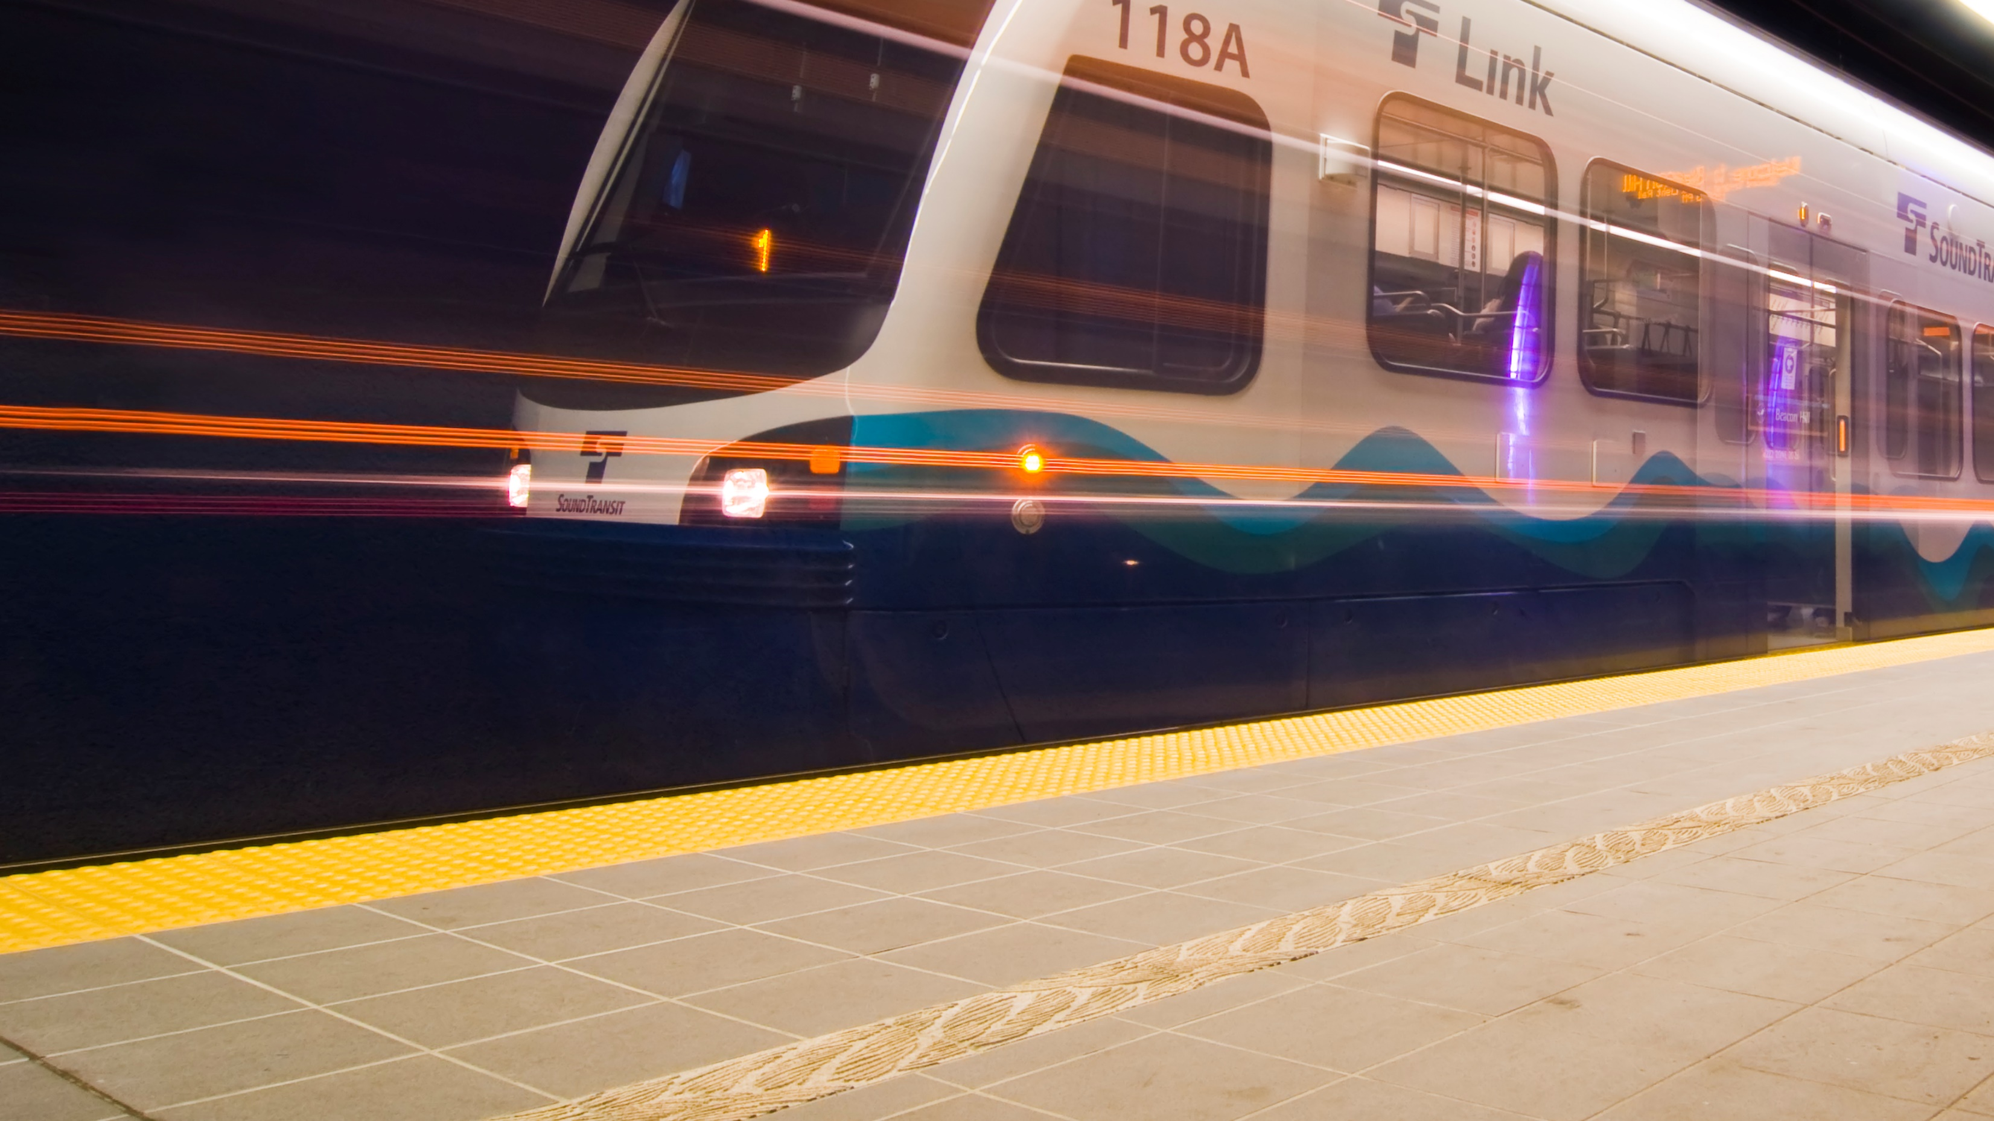

West Seattle and Ballard
Link Extensions
System Expansion Committee | February 14, 2019

Slide 2

Agenda
Alternatives development process
Level 3 alternatives
Level 3 evaluation results
Potential mix-and-match opportunities
2
Notes:
These are the main topic areas we’ll go over today.

Slide 3





Alternatives development process
LEVEL 1
LEVEL 2
LEVEL 3
PREFERRED
ALTERNATIVE*
Alternatives development
Alternatives development
Alternatives development
Early-2018
Mid-2018
Late-2018 / Early-2019
Early-2019
Conduct early scoping
Study ST3 representative project and alternatives
Screen alternatives
Technical analysis
Refine and screen alternatives
Refine and screen alternatives
Conduct Environmental Impact Statement
(EIS) scoping
PUBLIC INVOLVEMENT
PUBLIC INVOLVEMENT
PUBLIC INVOLVEMENT
*The Sound Transit Board identifies preferred alternatives and other alternatives to study.

Slide 4
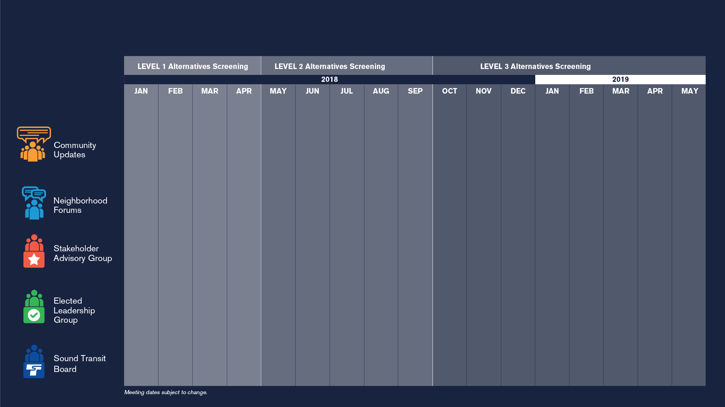

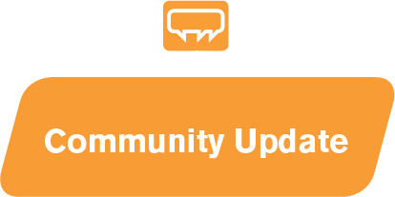
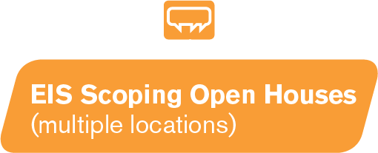
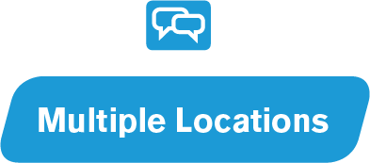



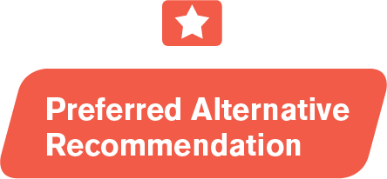
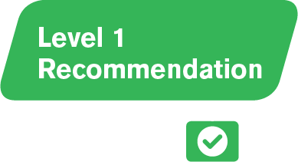
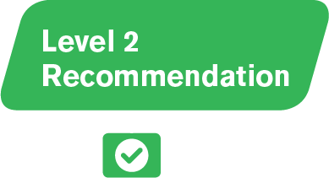
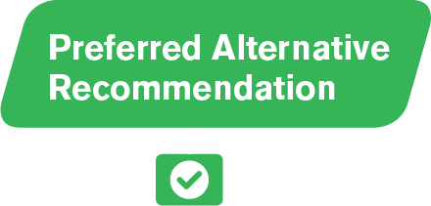

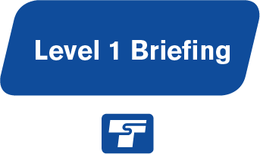
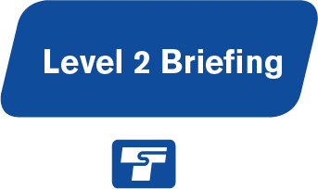
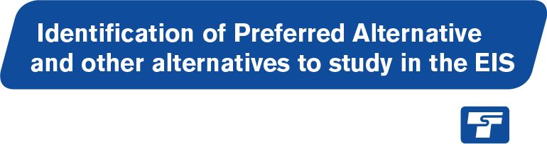
Community engagement and collaboration
Early
Scoping Period
EIS
Scoping
Period
4

Slide 5
Level 3 alternatives screening
SAG Meeting #12 | Jan 30 | Level 3 evaluation results
ELG Meeting #6 | Feb 1 | Level 3 evaluation results
EIS Scoping Open Houses / Neighborhood Forums | Feb 27, 28 & March 7 | Level 3 evaluation results
ELG Meeting #7 | March 29 | CID station focus
SAG Meeting #13 | April 17 or 18 | Level 3 recommendations
ELG Meeting #8 | April 26 | Level 3 recommendations
Sound Transit Board System Expansion Committee | May 9 | Identify preferred alternative (and other EIS alternatives)
Sound Transit Board Full Board | May 23 | Identify preferred alternative (and other EIS alternatives)
5

Slide 6
What is EIS Scoping?
Start of federal environmental review process
30-day public comment period begins February 15
Seeking public feedback on scope of EIS
  Range of alternatives
  Topics to study
  Purpose and need
Informs Board decision on what to study in EIS*
* Scope of EIS also subject to Federal Transit Administration (FTA) oversight
6
Notes:
Open process for determining what to consider in an EIS:
range of actions,
alternatives, and
impacts
30-day comment period for public, agency, and tribal comments.
To determine Preferred Alternative and alternatives to study in EIS
Sound Transit Board will consider:
Screening evaluation results
Scoping comments
Federal Transit Administration (FTA) direction
Community input and results of Racial Eq uity Toolkit
Want to point out here that FTA has a role in determining what a reasonable range of alternatives is and what goes into the EIS.

Slide 7
How to provide scoping comments
Attend an open house:
  West Seattle on Wednesday, Feb. 27, 6 – 8:30 p.m. at Alki Masonic Center
  Ballard/Interbay on Thursday, Feb. 28, 6 – 8:30 p.m. at Ballard High School
  Downtown on Thursday, March 7, 5 – 7:30 p.m. at Union Station
Comment online: wsblink.participate.online
Email us: wsbscopingcomments@soundtransit.org
Leave a voicemail: 833-972-2666
Mail us:
  West Seattle and Ballard Link Extensions, c/o Lauren Swift, Sound Transit, 401 S. Jackson St., Seattle, WA 98104
7

Slide 8
Screening process
Broad range of initial alternatives
Refine remaining alternatives
Further
evaluation
Preferred Alternative and other EIS alternatives
8

Slide 9
Level 3 recommendations
Interest in additional scope items
Additional scope items require 3rd party funding*
Potential recommendations:
  Preferred Alternative #1: If 3rd party funding not secured
  Preferred Alternative #2: If 3rd party funding is secured
* “3rd party funding” refers to potential local contribution/funding partnership(s) to supplement Sound Transit and federal funding
9

Slide 10
Level 3 alternatives screening
SAG Meeting #12 | Jan 30 | Level 3 evaluation results
ELG Meeting #6 | Feb 1 | Level 3 evaluation results
EIS Scoping Open Houses / Neighborhood Forums | Feb 27, 28 & March 7 | Level 3 evaluation results
ELG Meeting #7 | March 29 | CID station focus
SAG Meeting #13 | April 17 or 18 | Level 3 recommendations
ELG Meeting #8 | April 26 | Level 3 recommendations
Sound Transit Board System Expansion Committee | May 9 | Identify preferred alternative (and other EIS alternatives)
Sound Transit Board Full Board | May 23 | Identify preferred alternative (and other EIS alternatives)
10

Slide 11
Level 3 alternatives

Slide 12
Summary of Level 3 alternatives
ST3 Representative Project
West Seattle Elevated/ C-ID 5th Ave/
Downtown 6th Ave/ Ballard Elevated
  C-ID station options: 5th Ave Cut-and-Cover and 5th Ave Mined
West Seattle Tunnel/ C-ID 4th Ave/
Downtown 5th Ave/ Ballard Tunnel
  Junction station options: 41st Ave, 42nd Ave and 44th Ave
  C-ID station options: 4th Ave Cut-and-Cover and 4th Ave Mined
  Ballard station options: 14th Ave and 15th Ave
12

Slide 13
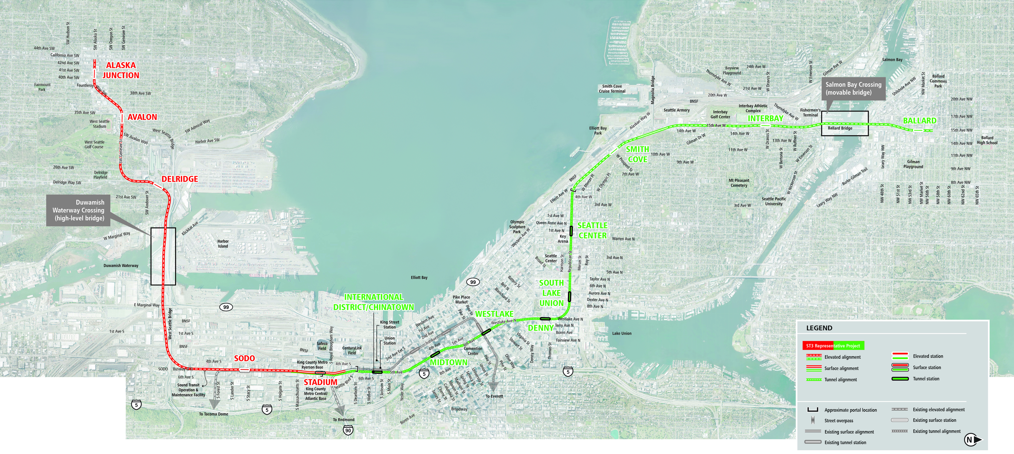
ST3 Representative Project
13

Slide 14
Summary of Level 3 alternatives
ST3 Representative Project
West Seattle Elevated/ C-ID 5th Ave/
Downtown 6th Ave/ Ballard Elevated
  C-ID station options: 5th Ave Cut-and-Cover and 5th Ave Mined
West Seattle Tunnel/ C-ID 4th Ave/
Downtown 5th Ave/ Ballard Tunnel
  Junction station options: 41st Ave, 42nd Ave and 44th Ave
  C-ID station options: 4th Ave Cut-and-Cover and 4th Ave Mined
  Ballard station options: 14th Ave and 15th Ave
14

Slide 15
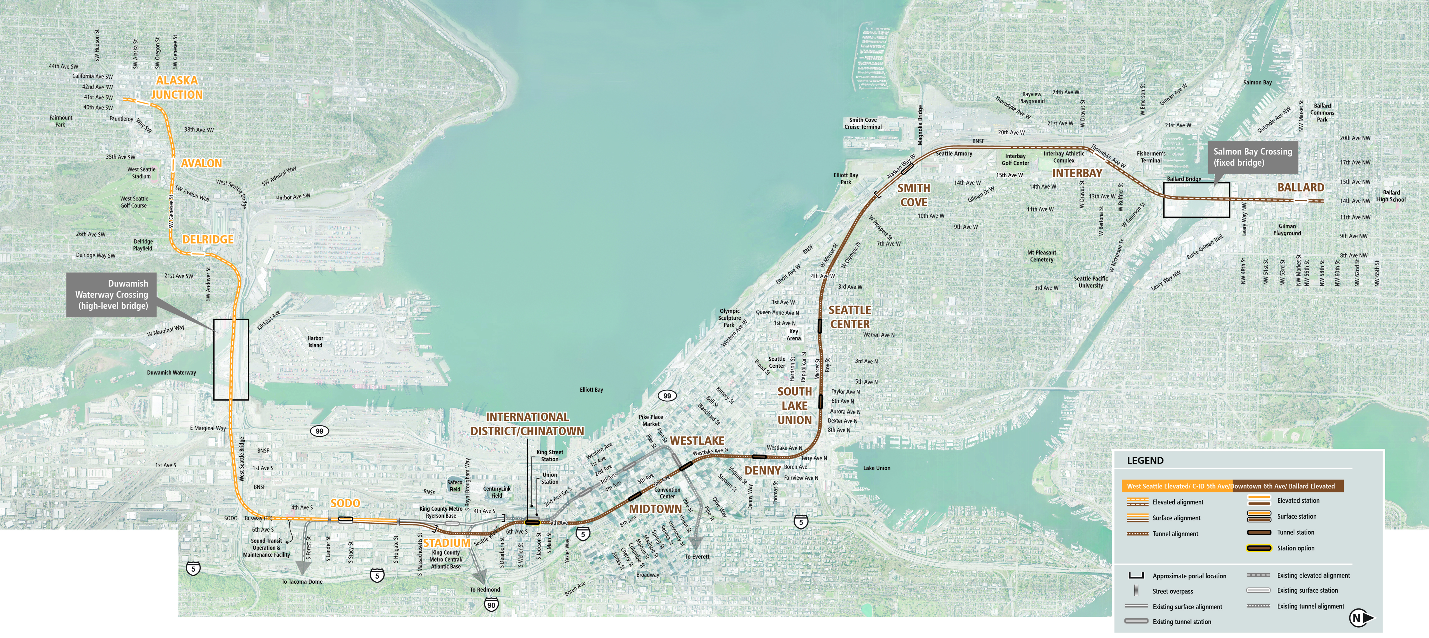
Alaska Junction elevated station oriented north/south
Interbay Station at 17th/Thorndyke
Smith Cove Station near Galer St
Delridge Station further south
High level fixed bridge at 14th Ave
6th Avenue route through downtown
Terry/Mercer route in South Lake Union
At grade along E-3 Busway
Chinatown/ID station options
5th Ave Bored Tunnel, Cut and Cover Station
5th Ave Mined
West Seattle Elevated/ C-ID 5th Ave/ Downtown 6th Ave/ Ballard Elevated
15

Slide 16
Summary of Level 3 alternatives
ST3 Representative Project
West Seattle Elevated/ C-ID 5th Ave/
Downtown 6th Ave/ Ballard Elevated
  C-ID station options: 5th Ave Cut-and-Cover and 5th Ave Mined
West Seattle Tunnel/ C-ID 4th Ave/
Downtown 5th Ave/ Ballard Tunnel
  Junction station options: 41st Ave, 42nd Ave and 44th Ave
  C-ID station options: 4th Ave Cut-and-Cover and 4th Ave Mined
  Ballard station options: 14th Ave and 15th Ave
16

Slide 17
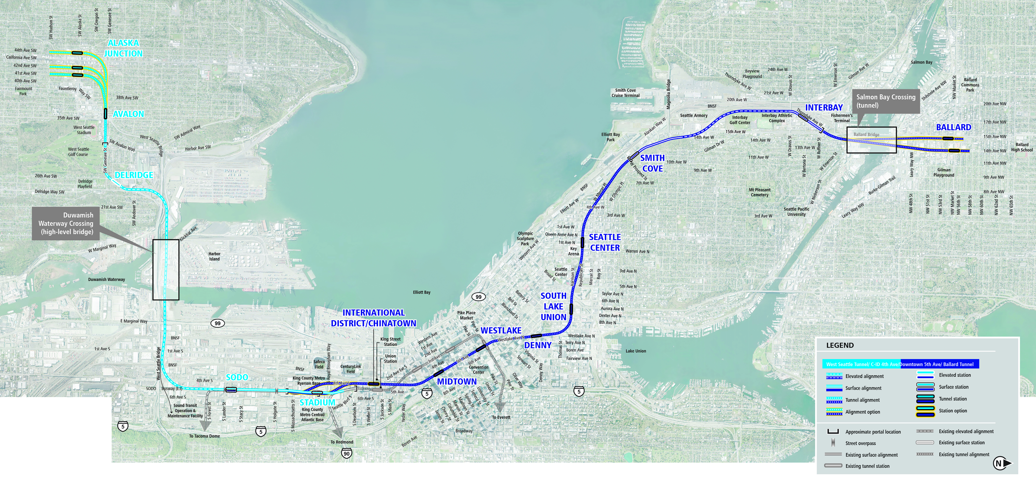
Junction tunnel station options
41st Ave
42nd Ave
44th Ave
Interbay Station at 17th/Thorndyke
Delridge Station further south and west
Ballard tunnel station options
14th Ave
15th Ave
North crossing of Duwamish
South Lake Union Station on Harrison
At grade along E-3 Busway
Chinatown/ID station options
4th Ave Cut and Cover
4th Ave Mined
West Seattle Tunnel/ C-ID 4th Ave/ Downtown 5th Ave/ Ballard Tunnel
17

Slide 18
Level 3 evaluation results

Slide 19
Evaluation criteria
17 criteria consistent in all levels of evaluation
  Reliable service
  Travel times
  Regional connectivity
  Transit capacity
  Projected transit demand
  Regional centers served
  ST Long-Range Plan consistency
  ST3 consistency
  Technical feasibility
  Financial sustainability
  Historically underserved populations
  Station area land use plan consistency
  Modal integration
  Station area development opportunities
  Environmental effects
  Traffic operations
  Economic effects
19
Notes:
These are the main topic areas we’ll go over today.

Slide 20
Measures and methods
50+ quantitative and/or qualitative measures
Ratings for Lower, Medium and Higher performing
Lower Performing
Medium
Performing
Higher
Performing
20

Slide 21
Comparative estimates
Purpose: To inform comparison of Level 3 alternatives
Comparative estimates for end-to-end alternatives
  Consistent methodology (2018$; construction, real estate, etc.)
  Based on limited conceptual design (less than 5% design)
  Does not establish project budget
Project budget established during final design (~ 2024)
21

Slide 22
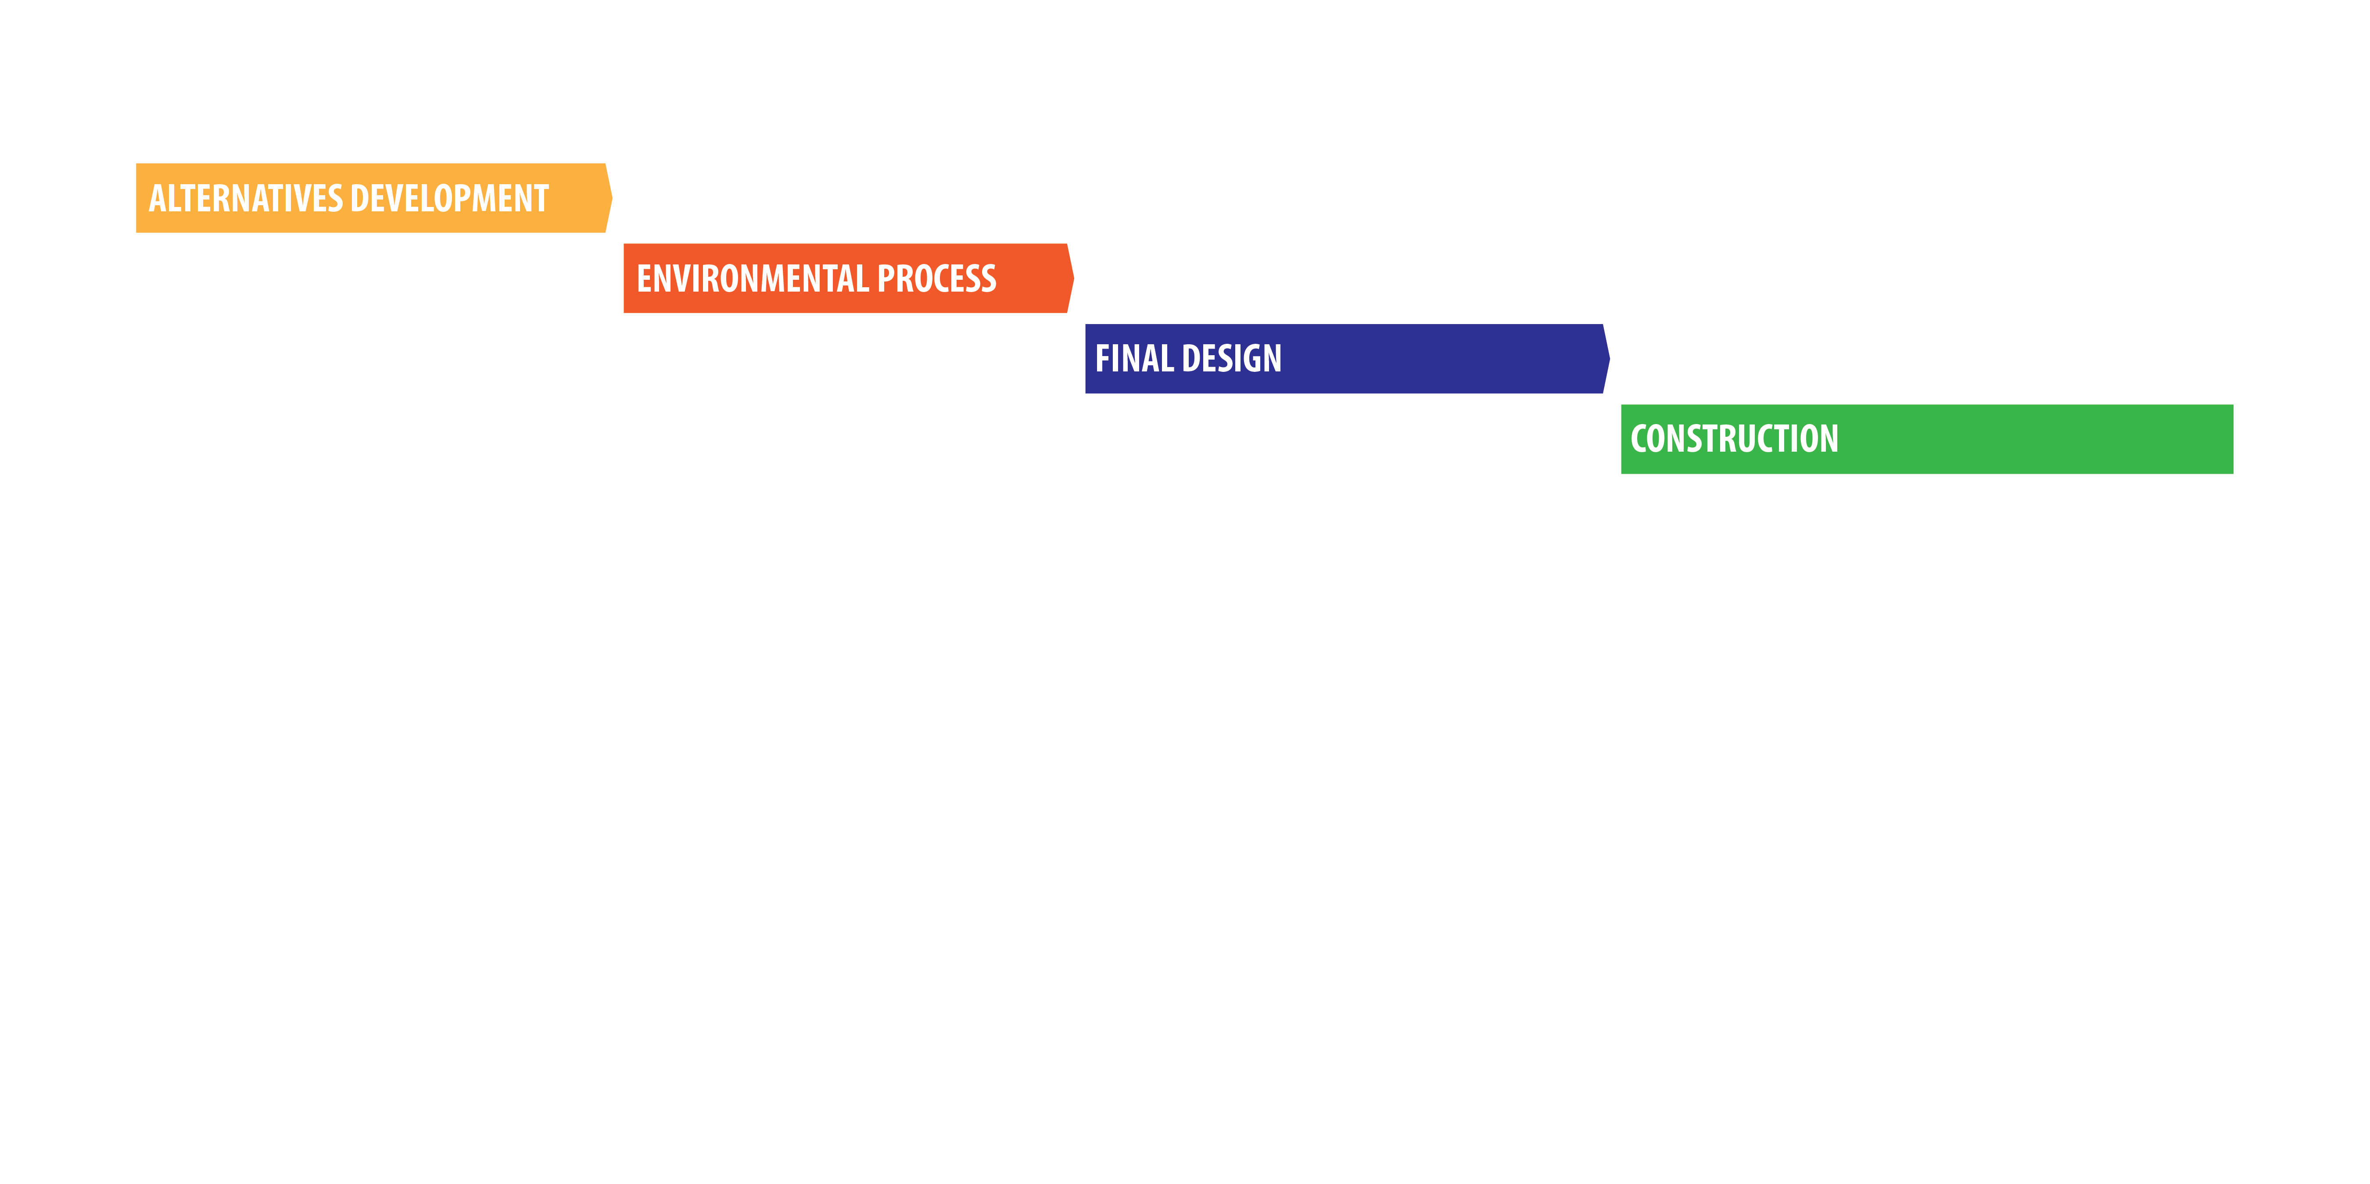
Project budget
22

Slide 23
Evaluation Measures | ST3 Representative | West Seattle Elevated/C-ID 5th Ave/Downtown 6th Ave/Ballard Elevated |  | West Seattle Tunnel/C-ID 4th Ave/Downtown 5th Ave/Ballard Tunnel
 | Project | 5th Ave Cut-and-Cover International District/ Chinatown Station | 5th Ave Mined International District/ Chinatown Station | 41st Ave Alaska Junction/4th Ave Cut-and-Cover/14th Ave Ballard | 42nd Ave Alaska Junction Station | 44th Ave Alaska Junction Station | 4th Ave Mined International District/ Chinatown Station | 15th Ave Ballard Station
Provide high quality rapid, reliable, and efficient peak and off-peak light rail transit service to communities in the project corridors defined in ST3.
At-grade crossings | 3 | 1 |  | 1
Potential service interruptions/recoverability | Lower | Medium |  | Medium |  |  | Lower | Medium
Improve regional mobility by increasing connectivity and capacity through downtown Seattle to meet projected transit demand.
Network Integration | Lower | Medium |  | Higher |  |  | Medium | Higher
Connect regional centers as described in adopted regional and local land use, transportation, and economic development plans and Sound Transit’s Regional Transit Long-Range Plan.
Accommodates future LRT extension | Lower | Medium |  | Higher |  | Medium | Higher
Implement a system that is consistent with the ST3 Plan that established transit mode, corridor, and station locations and that is technically feasible and financially sustainable to build, operate, and maintain.
Potential ST3 schedule effects | Higher | Higher | Medium | Lower
Potential ST3 operating plan effects | Lower | Higher |  | Higher |  |  | Medium | Higher
Engineering constraints | Lower | Medium |  | Lower
Constructability issues | Lower | Medium |  | Lower
Operational constraints | Lower | Medium | Lower | Higher |  |  | Lower | Higher
Capital costs (2018$) | - | +$400M | +$500M | +$1,900M |  |  | +$2,100M | +$1,900M
Encourage equitable and sustainable urban growth in station areas through support of transit-oriented development, station access, and modal integration in a manner that is consistent with local land use plans and policies.
Passenger transfers | Higher | Higher | Medium | Higher | Medium | Higher
Equitable development opportunities | Lower | Medium |  | Higher
Preserve and promote a healthy environment and economy by minimizing adverse impacts on the natural, built and social environments through sustainable practices.
Parks/recreational resource effects (acres) | 1.4 | 5.3 |  | 5.7
Water resource effects (acres) | 0.8 | 0.5 |  | <0.1
Fish and wildlife habitat effects (acres) | 15.0 | 6.0 |  | 15.0
Hazardous materials sites ⁽¹⁾ | 50 | 60 |  | 40
Visual effects to sensitive viewers (miles) | 2.5 | 1.7 |  | 1.2
Potentially affected properties | Medium | Lower |  | Higher
Residential unit displacements | Medium | Lower |  | Higher
Business displacements (square feet) | Higher | Lower |  | Higher
Construction impacts | Lower | Lower | Medium | Medium | Lower | Medium
Burden on minority/low-income | Lower | Medium |  | Lower
Traffic circulation and access effects | Lower | Medium |  | Higher
Effects on transportation facilities | Lower | Medium |  | Medium
Effects on freight movement | Lower | Medium |  | Medium
(1) On properties that overlap with the project footprint
Summary of differentiators
Lower Performing
Medium Performing
Higher Performing
23

Slide 24
Comparative estimates
10
9
8
7
6
Estimates based on limited conceptual design for the purpose of comparing alternatives only. Project budget established during final design (~2024).
5
2018 $ in billions
4
3
2
1
ST3 Representative Project
West Seattle Elevated/ C-ID 5th Ave/
Downtown 6th Ave/ Ballard Elevated
West Seattle Tunnel/ C-ID 4th Ave/
Downtown 5th Ave/ Ballard Tunnel
24

Slide 25
Potential mix-and-match opportunities

Slide 26
Summary of Level 3 alternatives
ST3 Representative Project
West Seattle Elevated/ C-ID 5th Ave/
Downtown 6th Ave/ Ballard Elevated
  C-ID station options: 5th Ave Cut-and-Cover and 5th Ave Mined
West Seattle Tunnel/ C-ID 4th Ave/
Downtown 5th Ave/ Ballard Tunnel
  Junction station options: 41st Ave, 42nd Ave and 44th Ave
  C-ID station options: 4th Ave Cut-and-Cover and 4th Ave Mined
  Ballard station options: 14th Ave and 15th Ave
26

Slide 27
Station near Prospect St (instead of Galer St)
Crossing on north (instead of south) side of existing bridge
5th/Harrison (instead of 6th/Mercer) route through Downtown
West Seattle Elevated/ C-ID 5th Ave/ Downtown 6th Ave/ Ballard Elevated – Potential mix-and-match opportunities
27

Slide 28
Summary of Level 3 alternatives
ST3 Representative Project
West Seattle Elevated/ C-ID 5th Ave/
Downtown 6th Ave/ Ballard Elevated
  C-ID station options: 5th Ave Cut-and-Cover and 5th Ave Mined
West Seattle Tunnel/ C-ID 4th Ave/
Downtown 5th Ave/ Ballard Tunnel
  Junction station options: 41st Ave, 42nd Ave and 44th Ave
  C-ID station options: 4th Ave Cut-and-Cover and 4th Ave Mined
  Ballard station options: 14th Ave and 15th Ave
28

Slide 29
Elevated (instead of tunnel) Alaska Junction and Avalon stations
Elevated (instead of tunnel) Ballard station
5th Ave (instead of 4th Ave) Chinatown/ID station
West Seattle Tunnel/ C-ID 4th Ave/ Downtown 5th Ave/ Ballard Tunnel – Potential mix-and-match opportunities
29

Slide 30
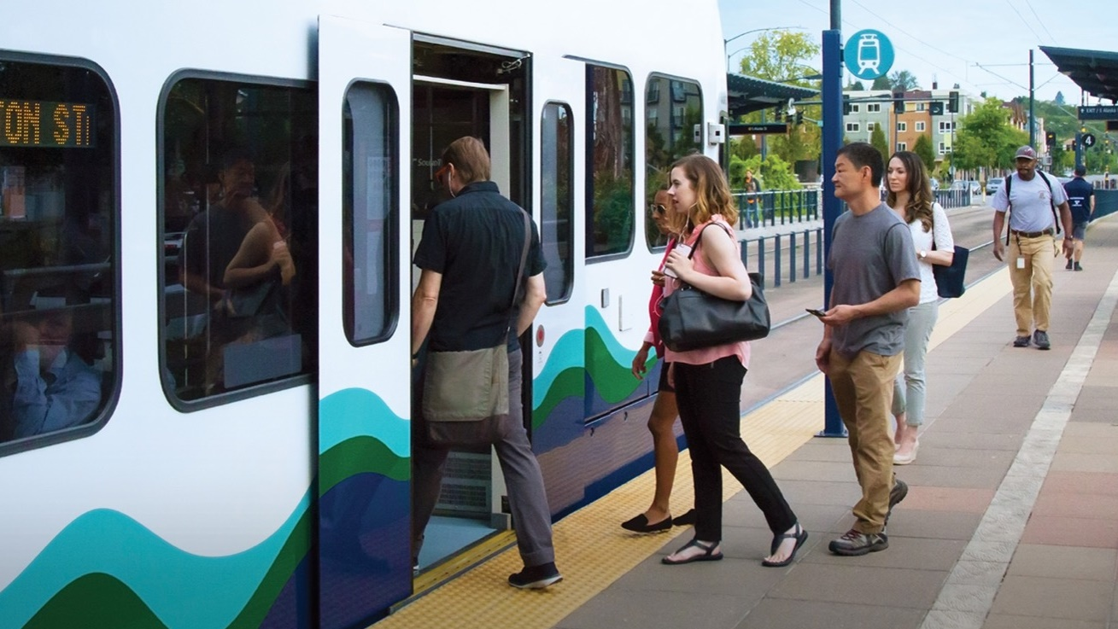
Next steps

Slide 31
Next steps
SAG Meeting #12 | Jan 30 | Level 3 evaluation results
ELG Meeting #6 | Feb 1 | Level 3 evaluation results
EIS Scoping Open Houses / Neighborhood Forums | Feb 27, 28 & March 7 | Level 3 evaluation results
ELG Meeting #7 | March 29 | CID station focus
SAG Meeting #13 | April 17 or 18 | Level 3 recommendations
ELG Meeting #8 | April 26 | Level 3 recommendations
Sound Transit Board System Expansion Committee | May 9 | Identify preferred alternative (and other EIS alternatives)
Sound Transit Board Full Board | May 23 | Identify preferred alternative (and other EIS alternatives)
31

Slide 32

soundtransit.org/wsblink

Slide 33
Evaluation Measures | ST3 Representative | West Seattle Elevated/C-ID 5th Ave/Downtown 6th Ave/Ballard Elevated |  | West Seattle Tunnel/C-ID 4th Ave/Downtown 5th Ave/Ballard Tunnel
 | Project | 5th Ave Cut-and-Cover International District/ Chinatown Station | 5th Ave Mined International District/ Chinatown Station | 41st Ave Alaska Junction/4th Ave Cut-and-Cover/14th Ave Ballard | 42nd Ave Alaska Junction Station | 44th Ave Alaska Junction Station | 4th Ave Mined International District/ Chinatown Station | 15th Ave Ballard Station
Provide high quality rapid, reliable, and efficient peak and off-peak light rail transit service to communities in the project corridors defined in ST3.
At-grade crossings | 3 | 1 |  | 1
Potential service interruptions/recoverability | Lower | Medium |  | Medium |  |  | Lower | Medium
LRT travel times (minutes) | 6 to 7 / 13 to 14 | 6 to 7 / 13 to 14 |  | 6 to 7 / 13 to 14
Transit travel time savings (minutes) | 12 to 20 | 12 to 20 |  | 12 to 20
Improve regional mobility by increasing connectivity and capacity through downtown Seattle to meet projected transit demand.
Network integration | Lower | Medium |  | Higher |  |  | Medium | Higher
Passenger carrying capacity | Medium | Medium |  | Medium
Average weekday trips on West Seattle/ Ballard extensions (2042) | 35,000 to 40,000 / 123,000 to 163,000 | 35,000 to 39,000 / 120,000 to 158,000 |  | 35,000 to 41,000 / 125,000 to 165,000
Connect regional centers as described in adopted regional and local land use, transportation, and economic development plans and Sound Transit’s Regional Transit Long-Range Plan.
PSRC growth centers served | 5 | 5 |  | 5
Pop/job densities served (2040) | 38 / 39 | 39 / 39 |  | 37 / 38 to 39
Accommodates future LRT extension | Lower | Medium |  | Higher |  | Medium | Higher
Implement a system that is consistent with the ST3 Plan that established transit mode, corridor, and station locations and that is technically feasible and financially sustainable to build, operate, and maintain.
Mode, route and stations per ST3 | Higher | Higher |  | Higher
Potential ST3 schedule effects | Higher | Higher | Medium | Lower
Potential ST3 operating plan effects | Lower | Higher |  | Higher |  |  | Medium | Higher
Engineering constraints | Lower | Medium |  | Lower
Constructability issues | Lower | Medium |  | Lower
Operational constraints | Lower | Medium | Lower | Higher |  |  | Lower | Higher
Capital costs (2018$) | - | +$400M | +$500M | +$1,900M |  |  | +$2,100M | +$1,900M
Annual O&M costs on West Seattle/ Ballard extensions (2018$ in millions) | $25 to $30 / $55 to $60 | $25 to $30 / $55 to $60 |  | $25 to $30 / $55 to $60
Expand mobility for the corridor and region’s residents, which include transit dependent, low income, and minority populations.
Low-income/minority opportunities (activity nodes/rental units) ⁽¹⁾ | Medium | Medium |  | Medium
 | 23% | 22% |  | 23%
Low-income population ^{(1/2)} | 32% / 32% | 32% / 32% |  | 32% / 31%
Minority population ^{(1/2)} | 34% / 34% | 34% / 35% |  | 34% / 34 to 35%
Youth population ^{(1/2)} | 7% / 10% | 7% / 9% |  | 7% / 9 to 10%
Elderly population ^{(1/2)} | 14% / 11% | 14% / 12% |  | 14% / 11 to 12%
Limited English Proficiency population ^{(1/2)} | 7% / 8% | 7% / 8% |  | 7% / 7 to 8%
Disabled population ^{(1/2)} | 12% / 11% | 12% / 11% |  | 12% / 11%
(1) Within station walksheds; (2) Within 15 minute ride on connecting high frequency transit
Level 3 evaluation – Part 1 of 2
Lower Performing
Medium Performing
Higher Performing
Overview of Key Differentiators
33

Slide 34
Evaluation Measures | ST3 Representative | West Seattle Elevated/C-ID 5th Ave/Downtown 6th Ave/Ballard Elevated |  | West Seattle Tunnel/C-ID 4th Ave/Downtown 5th Ave/Ballard Tunnel
 | Project | 5th Ave Cut-and-Cover International District/ Chinatown Station | 5th Ave Mined International District/ Chinatown Station | 41st Ave Alaska Junction/4th Ave Cut-and-Cover/14th Ave Ballard | 42nd Ave Alaska Junction Station | 44th Ave Alaska Junction Station | 4th Ave Mined International District/ Chinatown Station | 15th Ave Ballard Station
Encourage equitable and sustainable urban growth in station areas through support of transit-oriented development, station access, and modal integration in a manner that is consistent with local land use plans and policies.
Compatibility with Urban Centers/Villages ⁽¹⁾ | 58% | 56% |  | 55 to 58%
Station land use plan consistency | Higher | Higher |  | Higher
Activity nodes served ⁽¹⁾ | 302 | 298 |  | 300 to 303
Passenger transfers | Higher | Higher | Medium | Higher |  |  | Medium | Higher
Bus/rail and rail/rail integration ⁽¹⁾ | Medium | Medium |  | Medium
Bicycle infrastructure and accessibility ⁽¹⁾ | 19% | 19% |  | 18 to 19%
Pedestrian/limited mobility accessibility | Higher | Higher |  | Higher
Development potential ⁽¹⁾ | 14% | 14% |  | 13 to 14%
Equitable development opportunities | Lower | Medium |  | Higher
Preserve and promote a healthy environment and economy by minimizing adverse impacts on the natural, built and social environments through sustainable practices.
Historic properties/Landmarks ⁽²⁾ | 40 | 20 |  | 40
Potential archaeological resource effects ⁽¹⁾ | Lower | Lower |  | Lower
Parks/recreational resource effects (acres) | 1.4 | 5.3 |  | 5.7
Water resource effects (acres) | 0.8 | 0.5 |  | <0.1
Fish and wildlife habitat effects (acres) | 15.0 | 6.0 |  | 15.0
Hazardous materials sites ⁽²⁾ | 50 | 60 |  | 40
Visual effects to sensitive viewers (miles) | 2.5 | 1.7 |  | 1.2
Noise/vibration sensitive receivers ⁽¹⁾ | Medium | Medium |  | Medium
Potentially affected properties | Medium | Lower |  | Higher
Residential unit displacements | Medium | Lower |  | Higher
Business displacements (square feet) | Higher | Lower |  | Higher
Construction impacts | Lower | Lower | Medium | Medium |  |  | Lower | Medium
Burden on minority/low-income | Lower | Medium |  | Lower
Traffic circulation and access effects | Lower | Medium |  | Higher
Effects on transportation facilities | Lower | Medium |  | Medium
Effects on freight movement | Lower | Medium |  | Medium
Business and commerce effects | Medium | Medium |  | Medium
(1) Within station walksheds and/or defined buffer of alignment; (2) On properties that overlap with the project footprint
Level 3 evaluation – Part 2 of 2
Lower Performing
Medium Performing
Higher Performing
Overview of Key Differentiators
34

